Slide 1

#1D9A78
Nate’s Investment Advisory Firm
#347170
#5AE0BB
Stock Value Prediction
#92D050
#ADB9CA
#F9D8A3
Callum Stevenson, Jake Vanderweyst, Joel Palmer, Nathan Farquharson, Tim Sankey

Slide 2
Task Description
Key Areas
Description
Objective
The primary goal is to allocate $1 million USD across six target companies: Salesforce, Uber, Chipotle, Kraft Heinz, Estée Lauder, and Expedia for the week of July 22 to July 26 to maximize returns.
Data Overview
We are analyzing the historic, and forward-looking, stock data of the companies that comprise the S&P 500 to understand the market and identify patterns/insights to inform our portfolio allocation.
Model Development
We will deploy predictive models/techniques learned in class, including machine-based regression and classification, to create the most accurate and informative model.
Deployment
The insights from our predictive models will be used to allocate the $1 million USD between the six target companies that we believe will yield the greatest return over the selected period.

Slide 3
Timeline
1
2
3
Data Collection Period
Start date: January 2, 2020
End date: June 26, 2024
Collect price and basic trading data for S&P 500 companies
Modelling Period
Approached to allocate the client’s funds for the week of July 22
Use this time to build models and test performance on data collected
Perform predictions and allocate portfolio in preparation for the trading period
Trading Period
Buy on Monday, July 22, 2024
Sell on Friday, July 26, 2024
Post-Trading
Evaluate and reflect on performance
Role
We are financial advisors for a high-profile client with a very high-risk tolerance.
The client recently received $1 million USD from a friend who loaned them the money for a week, the client wants to generate a strong return with the money by investing in select S&P 500 stocks.

Slide 4
Project Structure – CRISP-DM
Deployment
Business Understanding
6
1
Implement the model for practical use.
Define project objectives from a business perspective.
Evaluation
Data Understanding
5
CRISP-DM Model
2
Assess the model to meet the business objectives.
Load initial data and familiarize with properties.
Modelling
Data Preparation
4
3
Apply modeling techniques to the cleaned dataset.
Clean data into the final dataset for modeling.

Slide 5
Business Understanding
CRISP-DM Model Part 1

Slide 6






Six Target Stocks
Chipotle is a fast-casual restaurant chain known for its customizable burritos, bowls, and tacos made with fresh, high-quality ingredients.
Opening Price: $53.48
Estée Lauder is a leading global beauty company recognized for its premium skincare, makeup, fragrance, and hair care products.
Opening Price: $98.89
Kraft Heinz is a global food industry giant renowned for its iconic brands and wide range of popular, high-quality products.
Opening Price: $33.15
Expedia is a leading online travel company that offers comprehensive travel services, including booking flights, hotels, and vacations.
Opening Price: $134.83
Uber is a global technology company that revolutionizes transportation by connecting riders with drivers through a user-friendly mobile app.
Opening Price: $67.53
Salesforce is a global leader in cloud-based customer relationship management (CRM) software.
Opening Price: $248.75

Slide 7
Data Understanding
CRISP-DM Model Part 2

Slide 8
Initial Variable Analysis
Variable
Description
Type
01
Date
Represents the specific trading day for which the stock data is recorded. It is typically formatted as YYYY-MM-DD.
Date String
02
Symbol
Unique identifier assigned to a publicly traded company on a stock exchange. For example, "CRM" for Salesforce.
Float
03
Adj Close
Represents the closing price after adjustments for all applicable splits and dividend distributions.
Float
04
Volume
Indicates the number of shares traded on a given trading day to reflect the level of activity.
Integer
05
Open, High,
Low, Close
Variables represent the stock price at various points during a trading day
Float

Slide 9
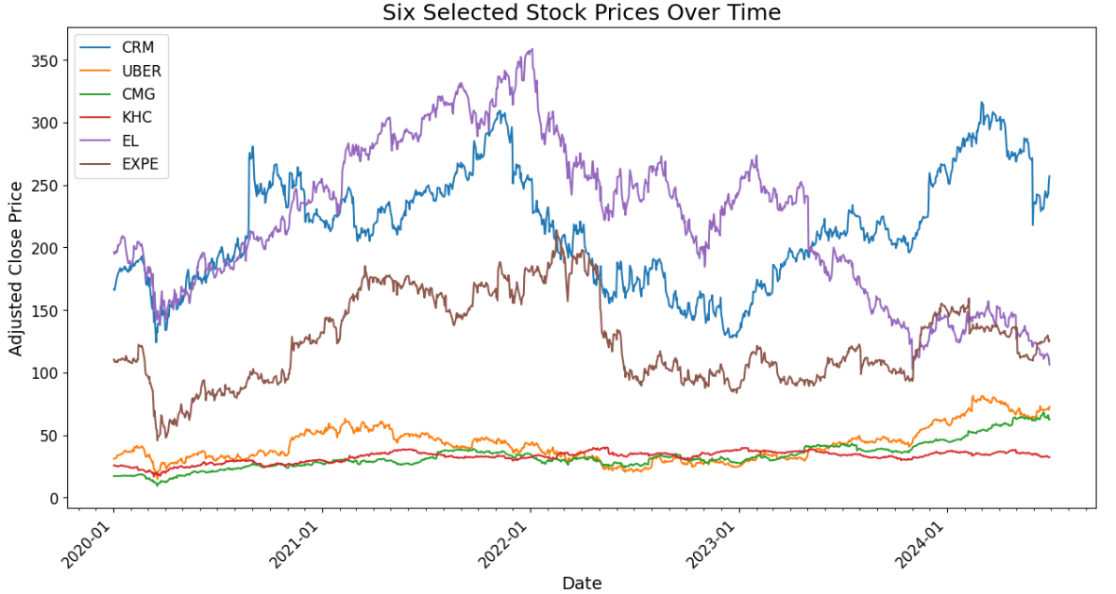
Trends of Target Companies
Upward trend since beginning | Steady trend throughout | Positive trend since 2022 | Large negative trend since 2022 | Negative since 2022 but bouncing back | Negative since 2022 but bouncing back

Slide 10
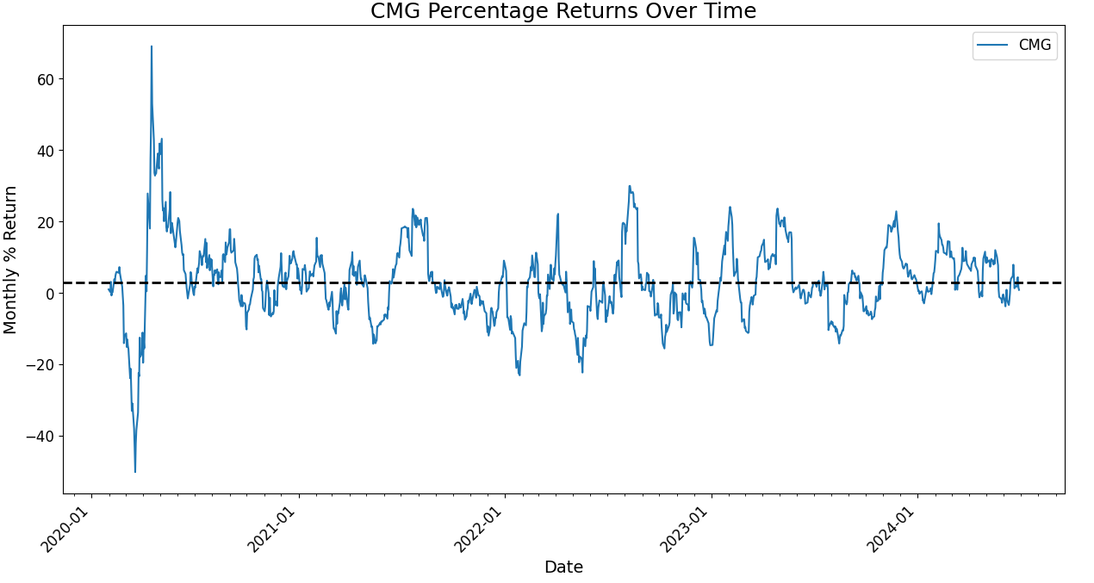
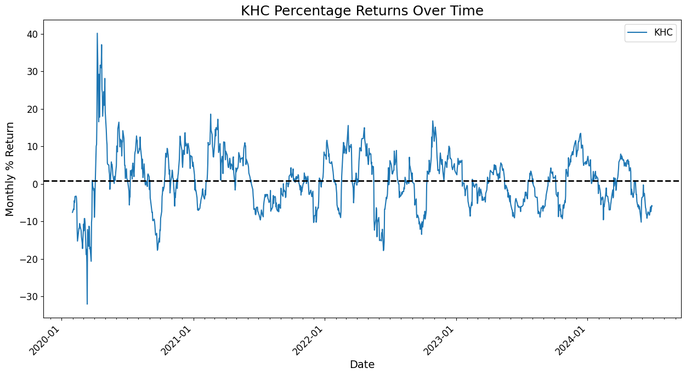
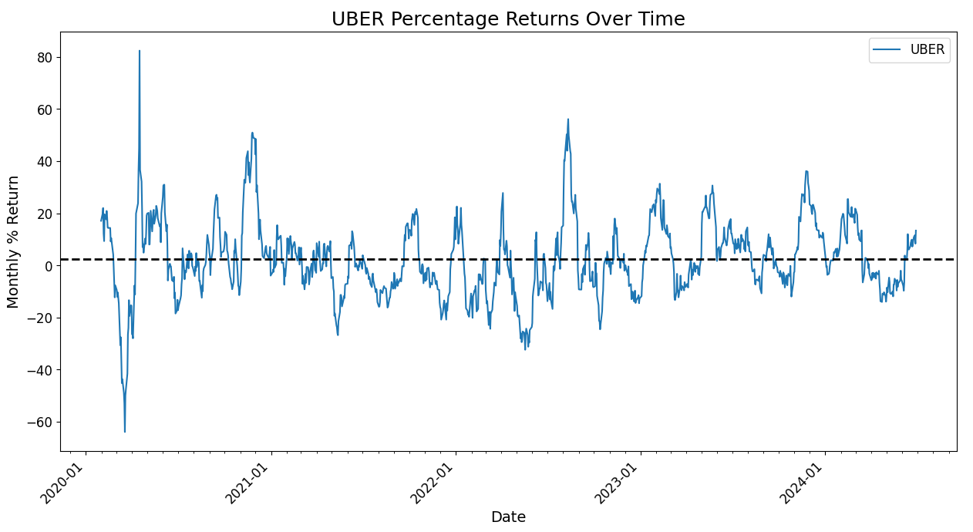
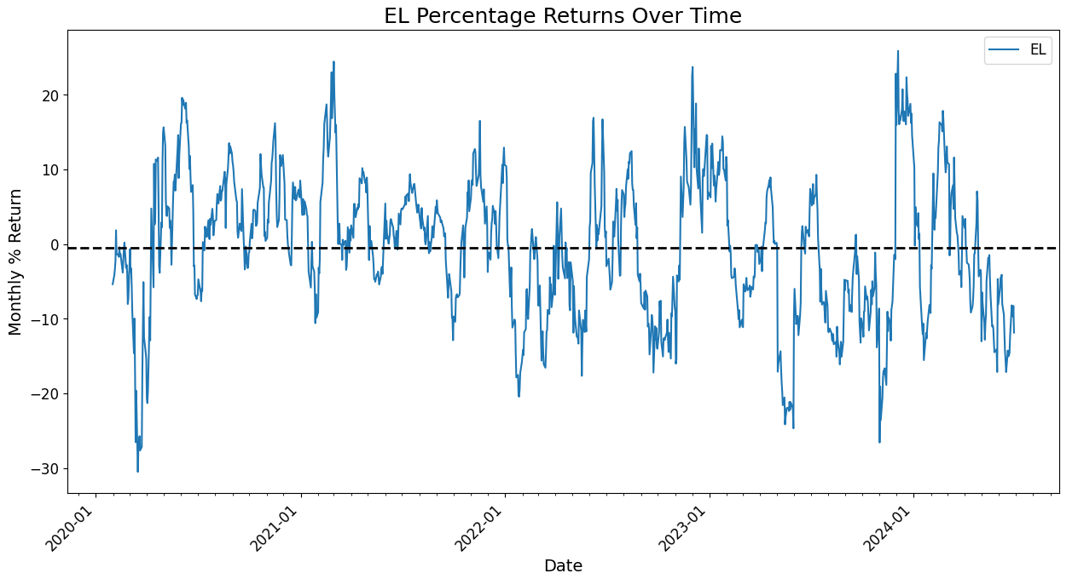
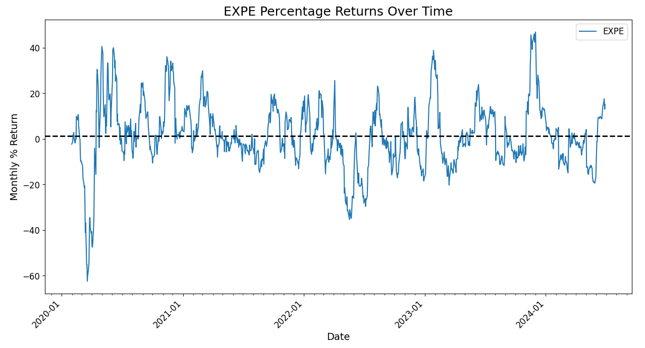
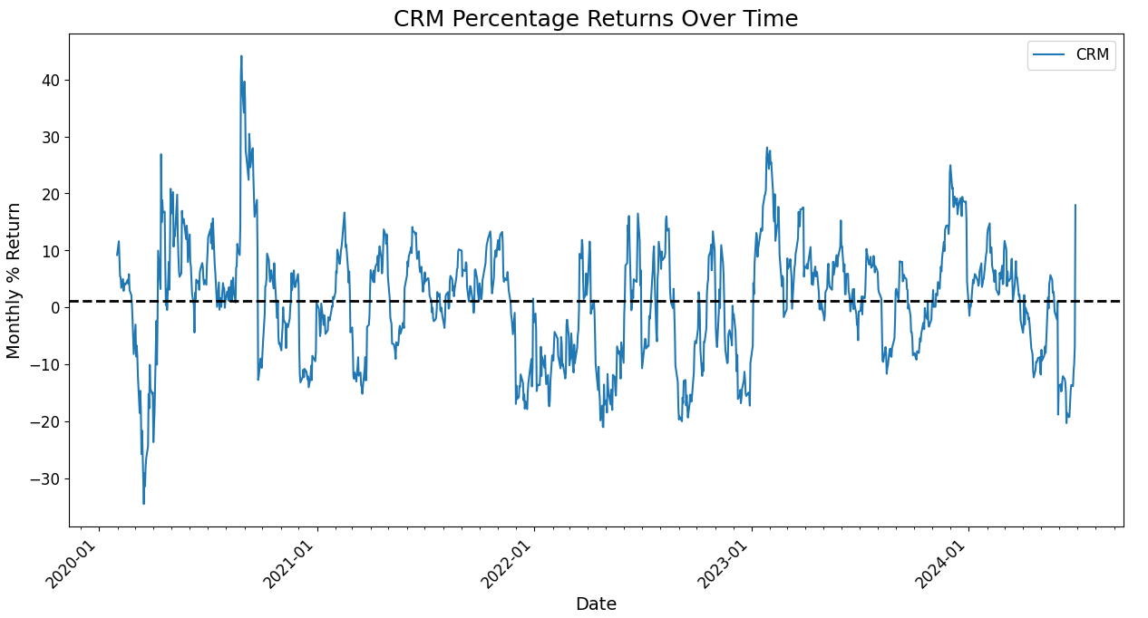
Average Monthly Return for Target Companies
Chipotle
KraftHeinz
Uber
Avg Return = 2.97%
Avg Return = 0.79%
Avg Return = 2.34%
Estee Lauder
Expedia
Salesforce
Avg Return = -0.50%
Avg Return = 1.33%
Avg Return = 1.06%

Slide 11
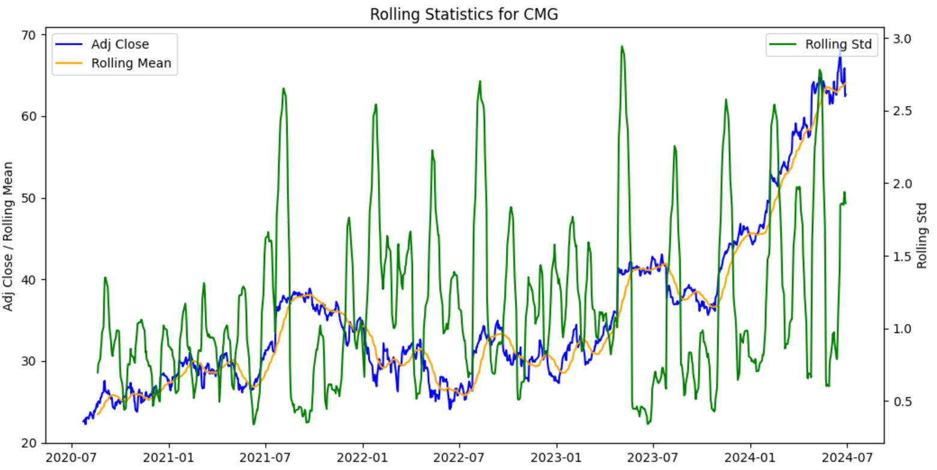
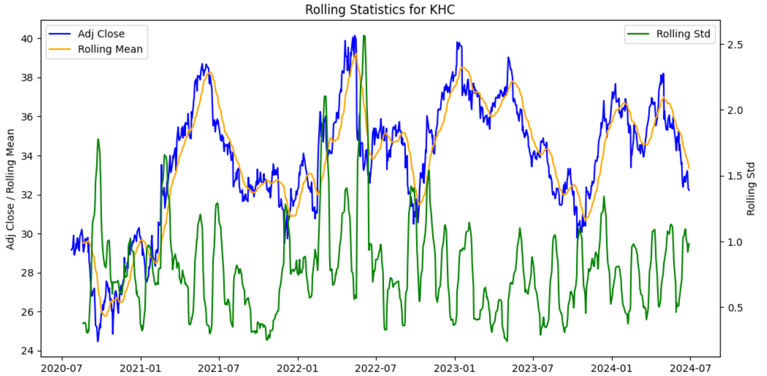
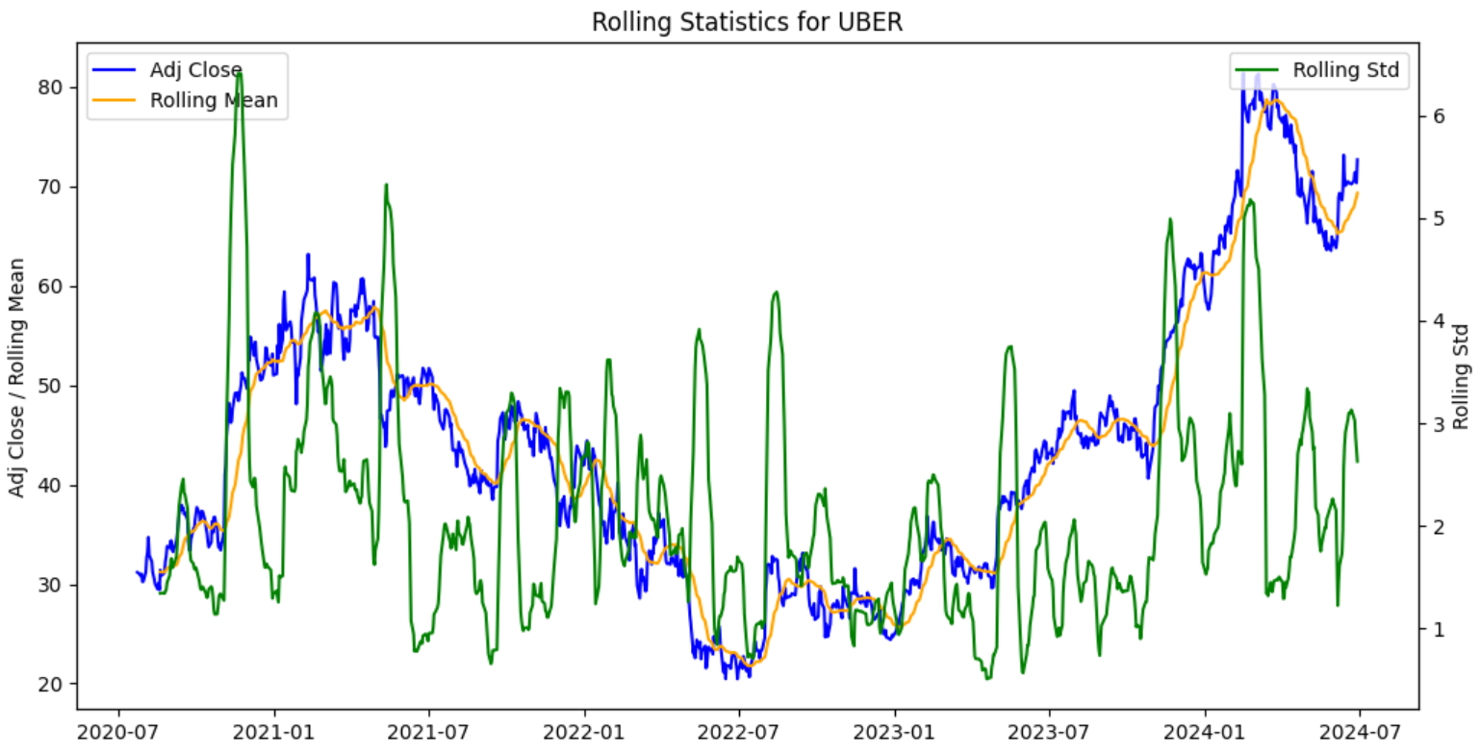
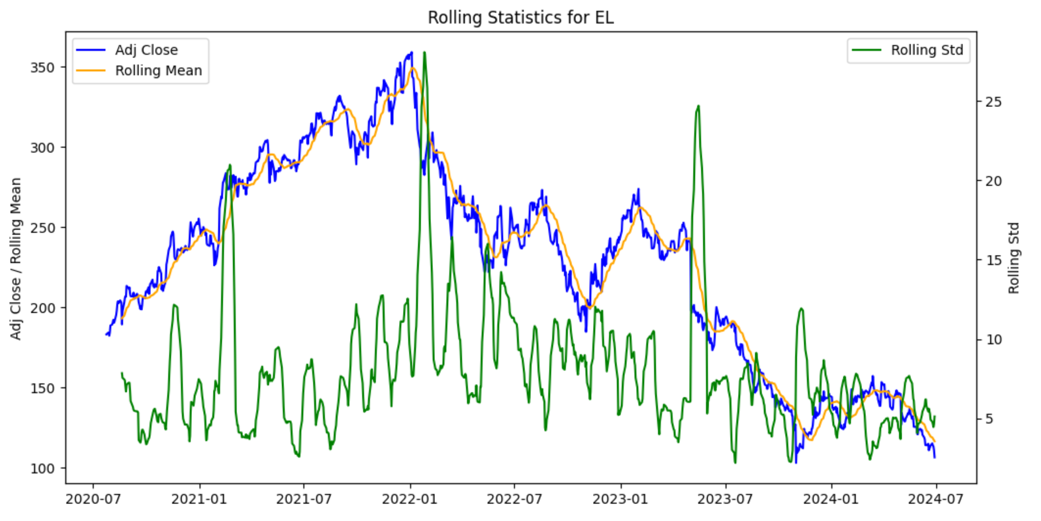
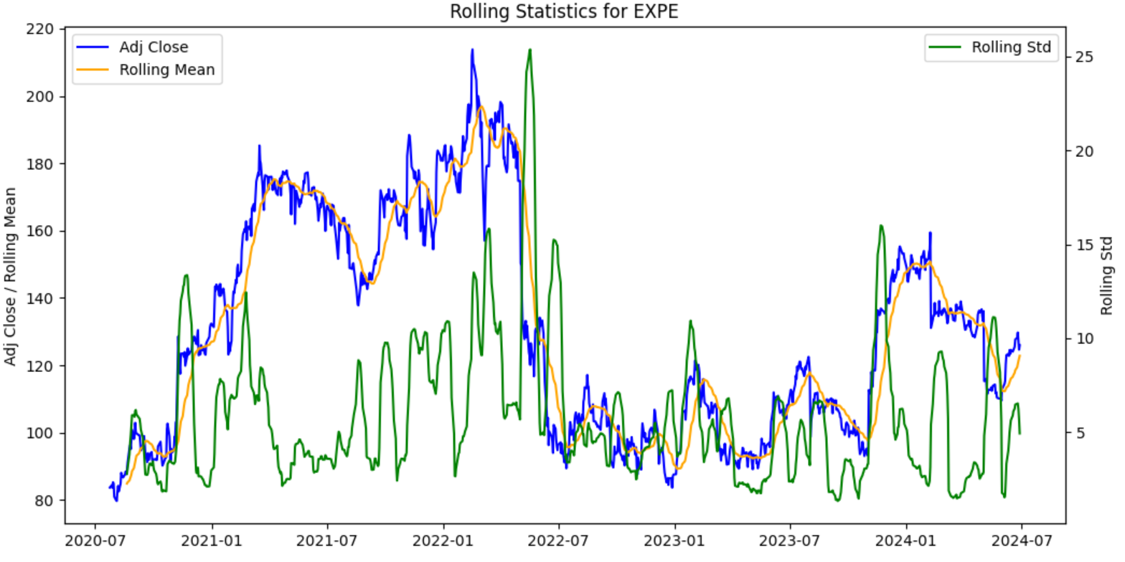
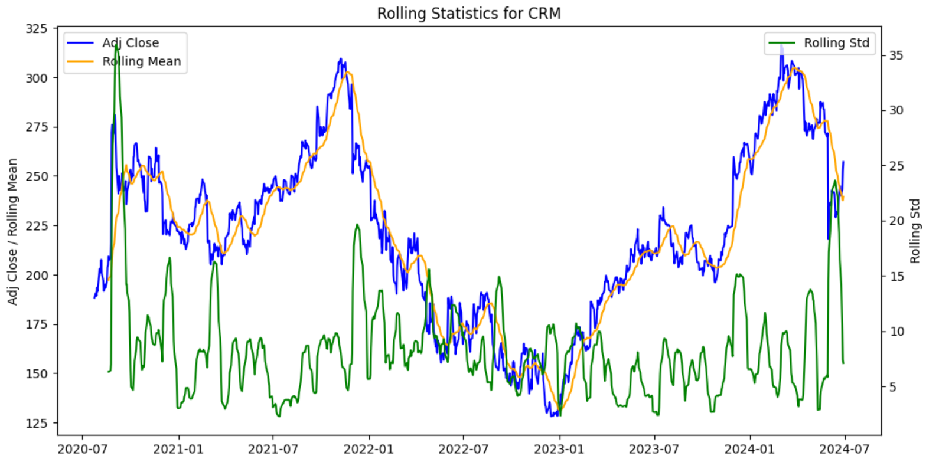
Rolling Statistics for Target Companies
Chipotle
KraftHeinz
Uber
Very high volatility
Strong upward trend in 2024
Very seasonal returns
Price oscillates along ~$34
High volatility through period
Trending upward since 2022
Estee Lauder
Expedia
Salesforce
Bursts of volatility
Trending down since 2022
Bursts of volatility
Dramatic fall in 2022
Recovered from 2022
Trending down in 2024

Slide 12
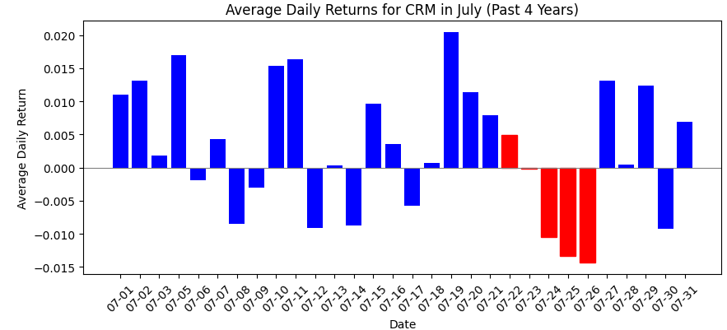
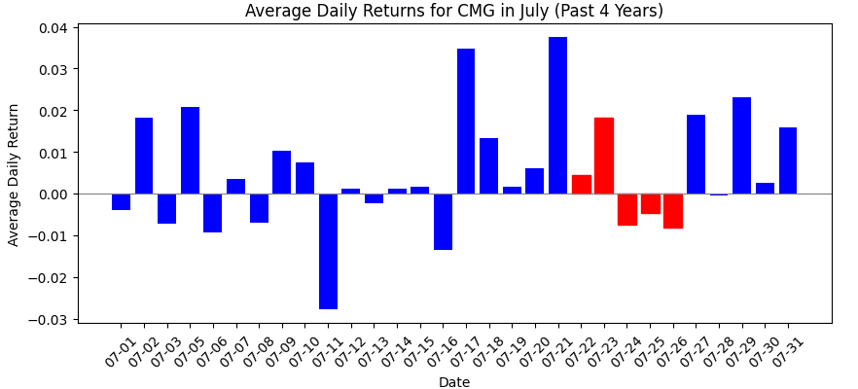
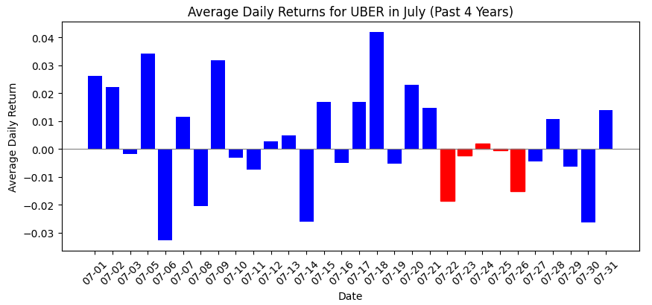
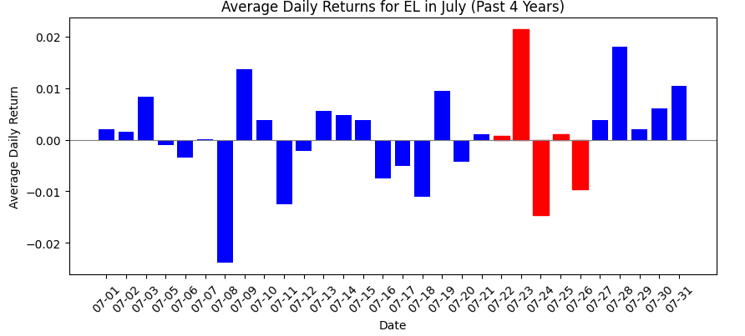
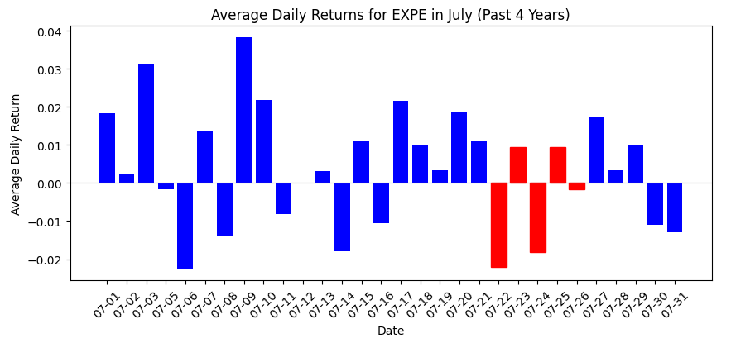
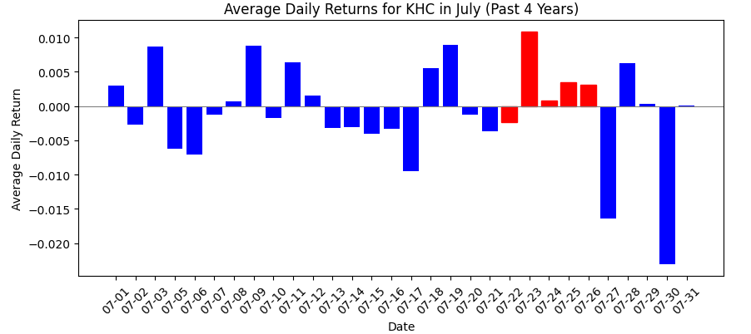
Historic Performance Week of July 22
These graphs show the historical performance on average for each stock from July 22 - July 26
Weaker Performing
Stronger Performing

Slide 13
Data Preparation
CRISP-DM Model Part 3

Slide 14

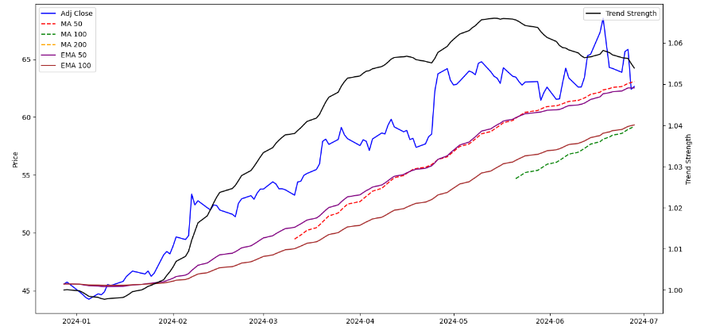

Categories of Variables: Trend Indicators
Trend Indicators: Mathematical calculations based on historical data that identify the strength and direction of a trend.
CMG Stock Price and Trend Indicators
MA
MA_50
MA_100
MA_200
Period Moving Average
EMA
EMA_50
EMA_100
Period Exponential Moving Average
TS
Trend_Strength
Strength of Trend
Trend Strength Calculated as the Ratio of the 50-day EMA to the 100-day EMA.
Helps Analyst and Traders to Identify direction and strength of a price movement in the market.
Notes:
These longer-term moving averages help to identify the strength and direction of a trend.
Used in:
Trend Direction Identification
Identifying market is in a uptrend, downtrend, or moving sideways.
Support and Resistance Levels
Can act as dynamic support and resistance levels, proving entry and exit points
Trend Strength Measurement
Whether a trend is likely to contiune or reverse.
Volatility Adjustment
Features like EMA are useful in more volatile markets.
Help in detecting critical points where the trend might change, providing valuable insights for trading strategies.

Slide 15

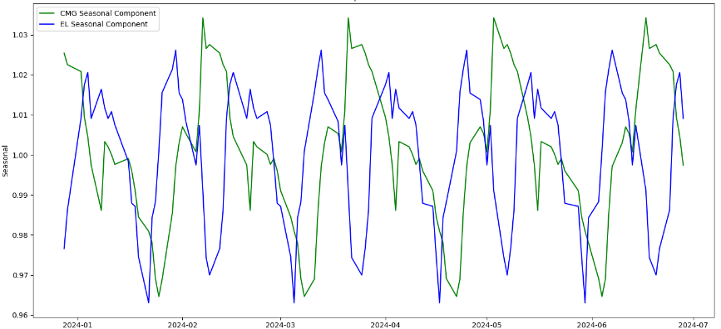
Categories of Variables: Seasonal Components
Time Series Decomposition: Technique used to break down a time series into constituent components, typically including trend, seasonal, and residual components.
Trend
Long-term movement, displays overall direction of the data over time
General direction of their data
Repeating short-term cycles in the time series at regular intervals
Seasonal analysis is useful for businesses with cyclical patterns
Residual
The random noise or irregular fluctuations
Seasonal
Identify unusual or unexpected variations in the data
Seasonal Components of CMG and EL
Notes:
Used to breakdown a timeseries into constituent components, including trend, seasonal, and residual components. Understanding these seasonal cycles, investors can make informed decisions about resource allocation, marketing strategies, and investment opportunities.
Trend
Provides insights into general direction in which the data is moving to identify long-term growth or decline.
Seasonal
Helps identify patterns that occur at regular intervals – quarterly reports, seasonal sales trends, or other periodic factors.
Residual
Identifying unusual or expected variations that cannot be explained by the trend or seasonal components.

Slide 16

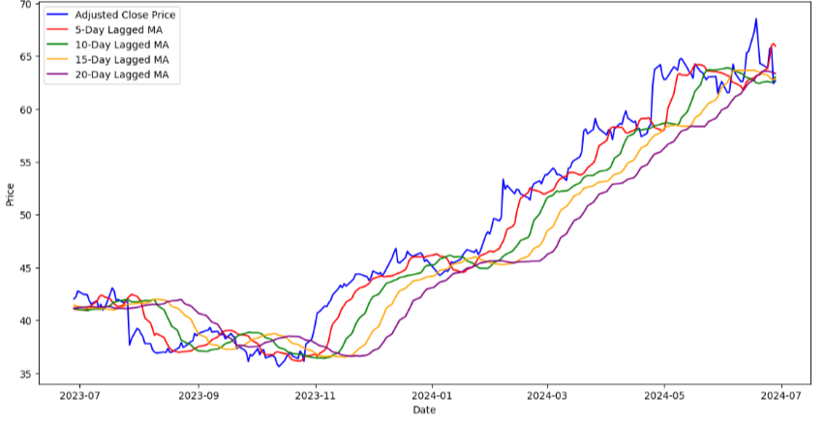
Categories of Variables: Lagged Moving Averages
Lagged Moving Averages: Incorporate past data points to smooth out short-term fluctuations and highlight longer-term trends
CMG Adjusted Close Price and Lagged MA
01
Lag_MA_5
5 Period Moving Average
02
Lag_MA_10
10 Period Moving Average
03
15 Period Moving Average
Lag_MA_15
04
20 Period Moving Average
Lag_MA_20
Calculated by Shifting Time Series Data by # of Days and Applying a Moving Average
Helps Analyst and Traders to Identify Trends and Potential Reversals in the Market
Notes:
Lagged Moving Averages
Use past data points to smooth our short-term fluctuations and highlight longer-term trends in the stock prices.
Essential tools for trends analysis, volatility smoothing, signal generation, and identifying support and resistance levels.
Primary Goal
Identify the overall direction of the stock price movement. Identifying a uptrend, downtrend, or if the security is moving sideways.
Incorporating these variables enhances the model ability to capture market dynamics and improve prediction accuracy.
Use in Model
Identifying crossover points can be crucial indicators for making trading decisions.
Insights into short-long and long-term trends, making our predictions more robust and reliable

Slide 17
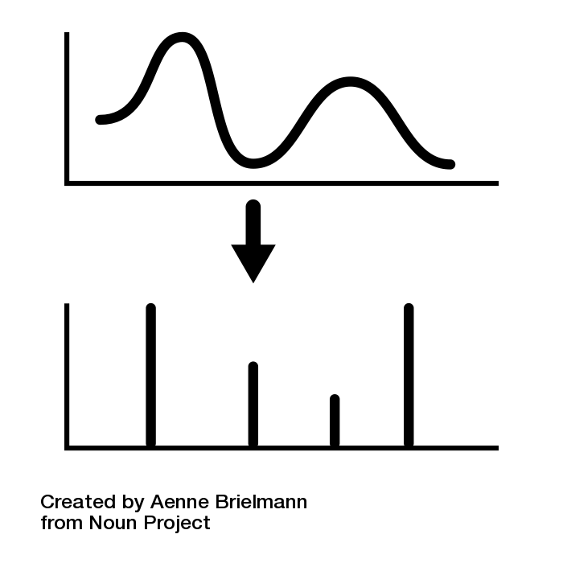
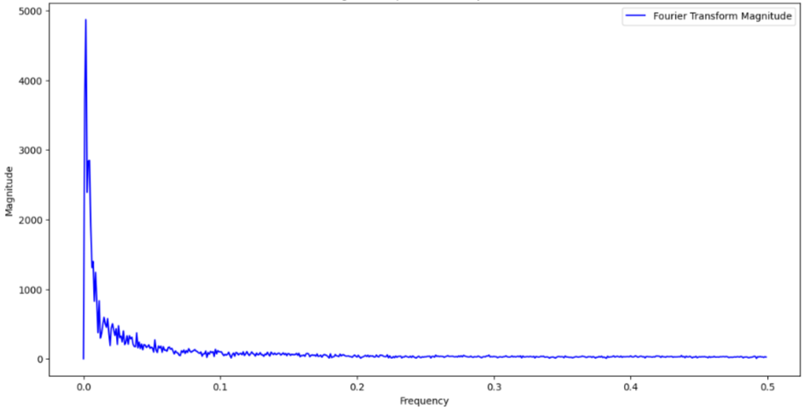
Categories of Variables: Fourier Transform
Fourier Transform: Mathematical technique that transforms time series into its constituent frequencies
Magnitude Spectrum
CMG Fourier Transform Magnitude Spectrum
Low Frequency
Longer Term Trend
High Frequency
Short-Term Cycles
Financial Analysis Implications
Both Short and Long Investment Horizon
Anticipate Potential Fluctuations and Manage Risk
Optimize Entry and Exit Points
Period | Frequency | Trend/Cycle
565.60 Days | 0.0018 | Economic Cycle and Company Performance
113.60 Days | 0.0088 | Quarterly Reports
Notes:
The Fourier Transform is a mathematical technique that transforms time series data into constituent frequencies.
Meaning of Results
Low Frequency – Longer Term Trends
High Frequency – Short-Term Fluctuations
Use Cases for Fourier Transform
Risk Management
Anticipate potential fluctuations and manage risk more effectively. A high-frequency component indicating increased volatility might promote an investors to hedge their investment.
Entry and Exit Points
Identifying cycles and trends that are not immediately obvious in the time-domain data.
Identifying cycles to time their trades better, buying at low points and selling at high points in the cycle.

Slide 18
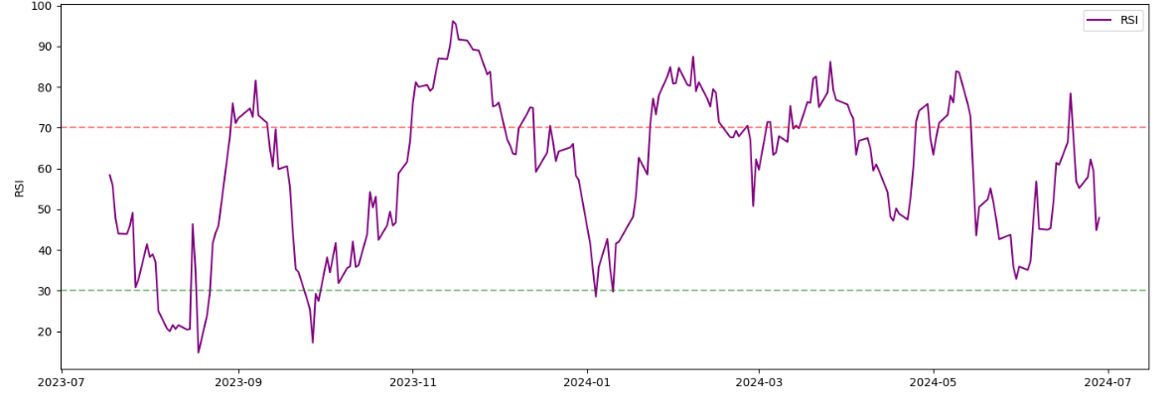
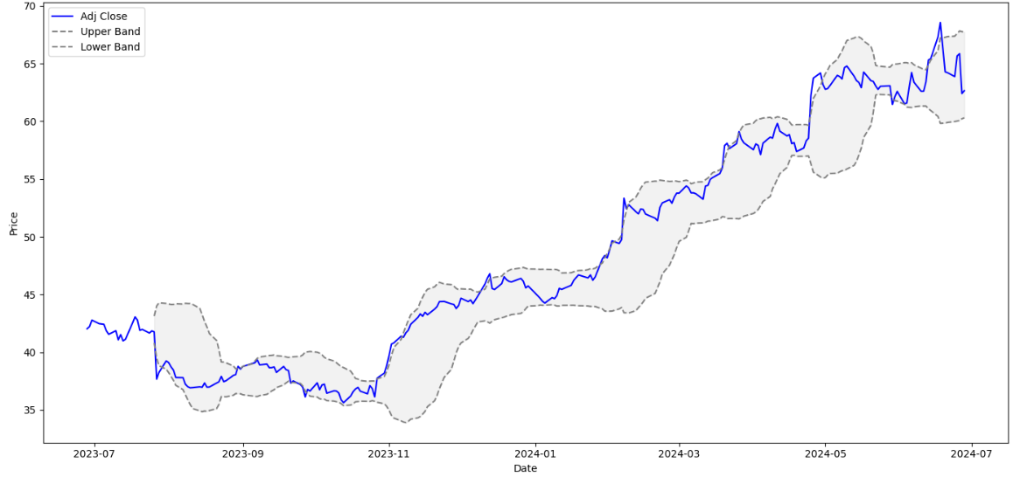
Categories of Variables: Technical Indicators
Technical Indictors: Calculations based on price, volume, or open interest that traders use to analyze securities and predict movements
RSI
Measures the Speed and Change of Price Movements
Bollinger Bands
Middle Band (SMA) and Two Outer Bands (Standard Deviation)
MACD
Indicates the Strength and Direction of Trend
EMA
Exponential Moving Averages (12 and 26 Day)
ADX
Measures Trend Strength
SMA
Simple Moving Averages (50 and 200 Day)
CMG: Relative Strength Index (Index)
CMG Adjusted Closing Price with Bollinger Bands
Notes:
Technical indicators are used to help understand market sentiment and make informed trading decisions.
Technical indicators help to identify:
Trend Identification
MACD and SMA can be used in recognizing the direction of the trends
Volatility Measurement
Bollinger Bands are used to gauge market volatility and help traders adjust strategies accordingly.
Strength of Trend
ADX can be used to quantify the strength of the current
Overbought / Oversold Conditions
RSI is used to detect overbought or oversold conditions to signal potential entry or exit points.
Using technical indicators traders can make informed decisions, manage risk more effectively, and optimize trading strategies.

Slide 19

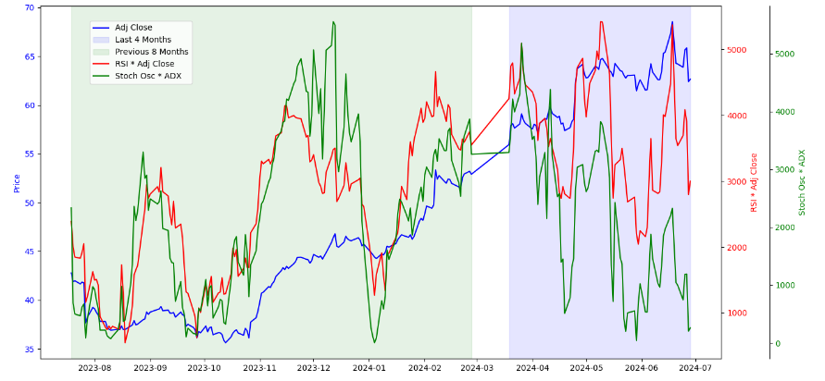
Categories of Variables: Interaction Features
Interaction Features: Created by Combining Two or More Existing Variables to Capture the Combined Effect
RSI * Adj Close
Combines Momentum with Actual Price Levels
CMG Performance Relative to Interaction Features
Can Highlight Oversold or Overbought Conditions
EMA 12 * Volume
Combines Trend Aspects with Trading Volume
High Values Volume suggest Strong Investor Interest and Confidence
Stoch Osc * ADX
Combines Momentum Aspects with Trend Strength
Identify Changes in Trend Strength and Momentum
Notes:
Interaction features help in understanding how different aspects of the market interact with each other, providing deeper insights and improving the predictive power of the model.
These aspects capture overbought / oversold conditions, features suggesting strong investor interest and confidence, and the changes in trend strength and momentum
The features help in detecting critical points where market conditions are likely to change, providing valuable insights for trading strategies.

Slide 20

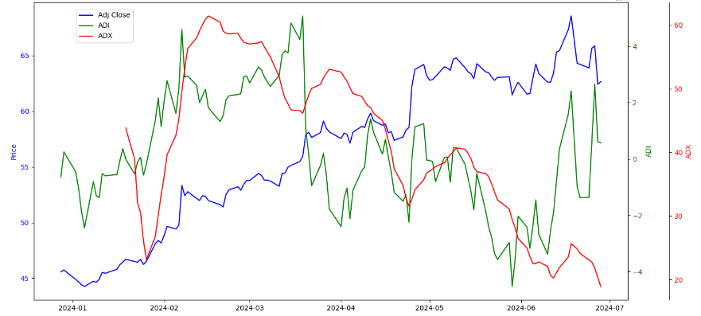
Categories of Variables: Volume-Based Features
Volume-Based Features: Analyzing trading volume data in conjunction with price movements
VPT
Combines price and volume to indicate the strength of price movements
CMG Stock Price, ADI, and ADX Trends
Volume Price Trend
OBV
On-Balance Volume
Measures buying and selling pressures
ADI
Accumulation/ Distribution Index
Combines price and volume to show supply and demand
CMF
Chaikin Money Flow
Measures the money flow volume over a specific period
FI
Force Index
Combines price and volume to measure the strength of price movements
Notes:
These features analyze trading volume data in conjunction with price movements. Proving insights into the strength and direction of price movements.
Use of Volume-Based Features
Validation of Price Trends
VPT and OBV help in confirming whether a price trend is backed by sufficient trading volume.
Identifying Buying and Selling Pressures
Features like OBV and CMF provide insight into underlying market sentiment, identifying if the market is dominated by buyers or sellers
Supply and Demand Analysis
ADI helps identifying periods of accumulation and distribution providing insight into potential future movements.
Measuring Market Momentum
FI helps to quantifying the force of price changes considering both price and volume to indicate the strength of market momentum.
These features help in detecting critical points where volume supports or contradicts price movements.

Slide 21

Modelling
CRISP-DM Model Part 4

Slide 22
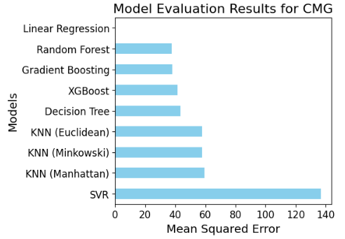
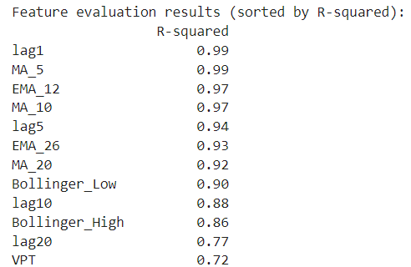
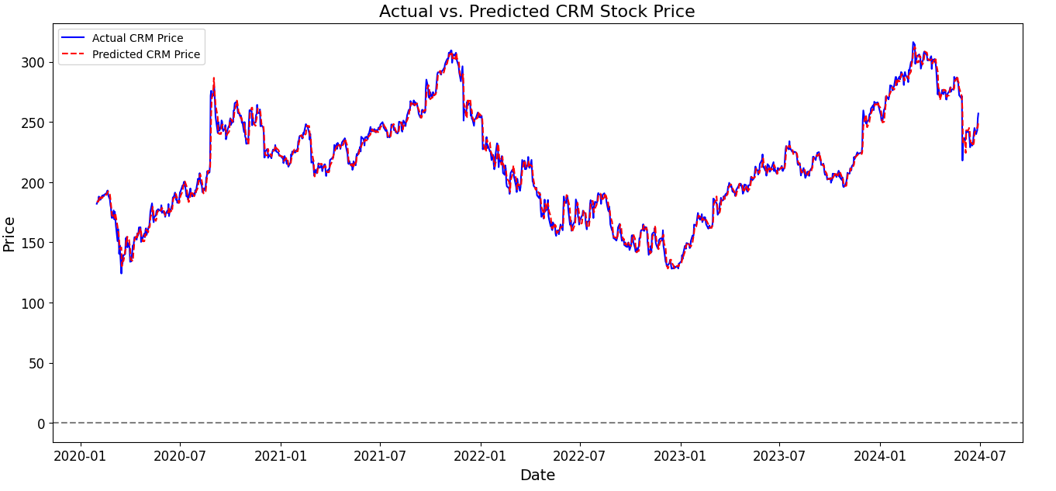
Historical Model Building
1. Linear Regression
We used our created variables as ‘X’ and Adj Close as ‘Y’ and evaluated the MSE of each model we've covered. Linear Regression was consistently the strongest
2. lag1, MA_5, MA_100, EMA_12, lag5
We tested the R squared of each individual variable on Adj Close to determine the 5 strongest in explaining variance. These variables predominately focus on historical moving averages
3. Create the Model
We ran the model for each stock overlaying it with historical prices

Slide 23
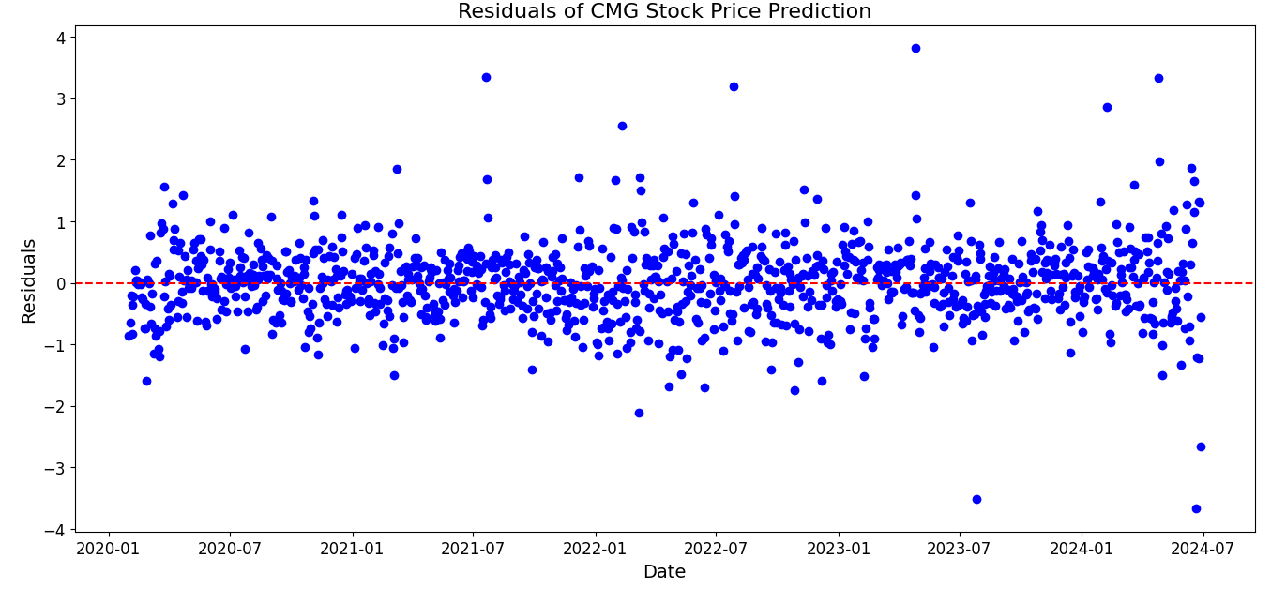
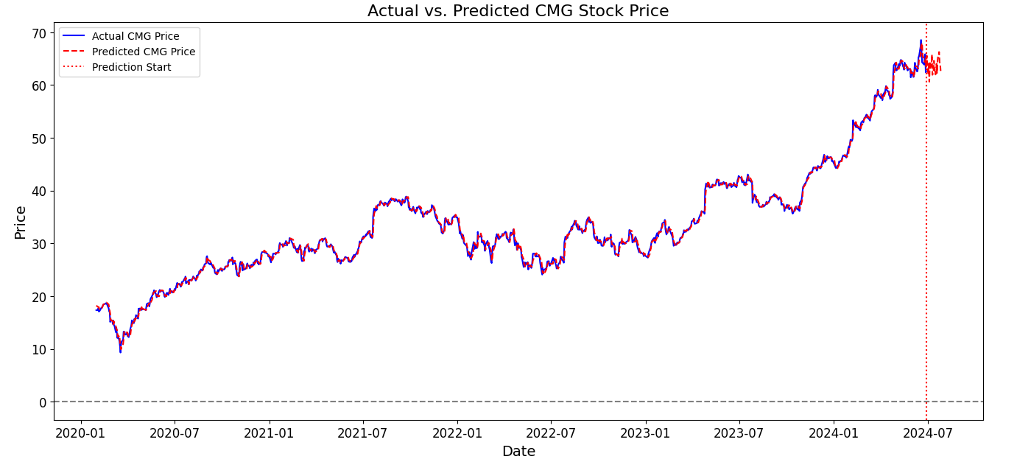
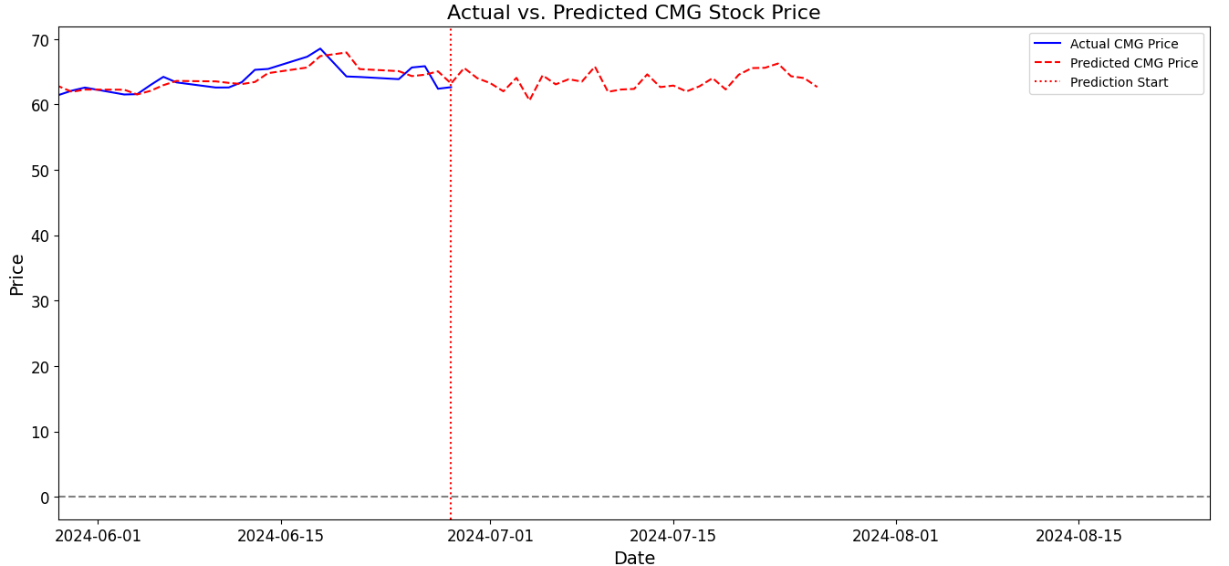
Historical Model Building
4. Evaluate the Model
Each model had an R square value >0.98, a reasonable MSE score and cross val score on R squared >0.96 showing strong predictability, unbiased and strong fitting
5. Predict Future Values
Using a random window approach along with a random shock based on historic data for volatility we predicted from the end of our data to 2024-07-19
6. Create the Model
We then predict to 2024-07-26 and obtain a return from the two projected dates

Slide 24
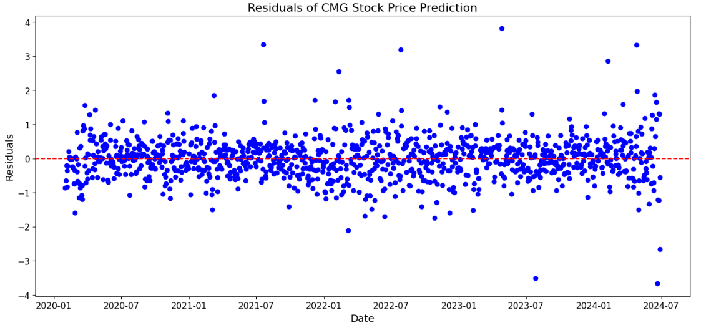
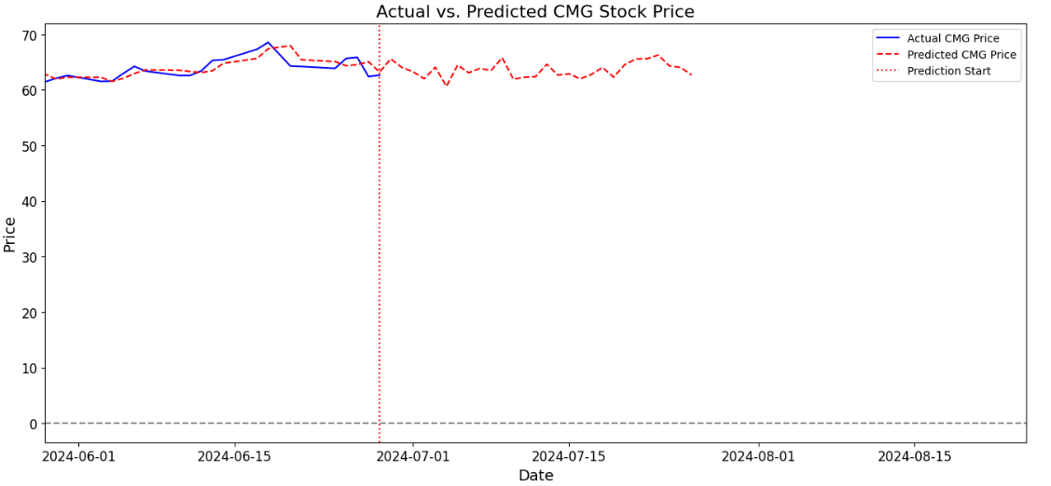
Historical Model Performance
Residual plot shows the model predictions are unbiased and consistent over time
Company | 2024-07-22 Opening Price | 2024-07-26 Projected Close | Return (%)
 | $53.48 | $62.68 | +17.20%
 | $33.15 | $31.78 | +4.31%
 | $67.53 | $69.73 | +3.26%
 | $98.89 | $103.67 | +4.83%
 | $134.83 | $123.22 | -8.61%
 | $248.75 | $247.71 | -0.42%
The model closely followed actual prices and continued the volatility into the predictions

Slide 25
Forward Predictive Model Building
1
Objective: Forecast stock prices 21 trading days ahead (between June 26 and July 26) with minimal error margins to inform portfolio allocation
2
Create Forward Lag Variable: Captures the gap between the end of historical data and the sale date
Calls the Adjusted Closing Price of the stock
Allows for direct comparison and prediction of a forward price based on a given day’s data
3
Variable Selection Process: Focused on the most influential predictors to enhance accuracy
Defined function to select best performing variables through a random forest regressor
Ranked variables based on importance in explaining change to target variable
4
Best-Performing Model: Iterated through various models to identify the top performer.
Tested all models covered in class with the selected predictive variables
Selected the model with the lowest MSE score to be used in price predictions
5
Price Prediction: Used the last 5 days of available data in the dataset to provide a detailed forecast for the week of July 22, 2024, to July 26, 2024, to offer insights into expected market trends for the week
Notes:
We forecasted stock prices 21 trading days ahead using a forward lag variable and the most influential predictors. Our model, based on the latest five days of data, provided detailed forecasts for the week of July 22, 2024, to July 26, 2024. These forecasts offer valuable insights into market trends, aiding in portfolio allocation.

Slide 26
Forward Predictive Model Performance
We forecasted stock prices 21 trading days ahead using a forward lag variable and the most influential predictors. Our model, based on the latest five days of data, provided detailed forecasts for the week of July 22, 2024, to July 26, 2024. These forecasts offer valuable insights into market trends, aiding in portfolio allocation.
Key Variables | ‘OBV’, ‘EMA_12’, ‘Bollinger_Low’, ‘Bollinger_High’ | ‘EMA_12’, ‘MACD’, ‘ADX’, ‘MACD*EMA_12’ | ‘Bollinger_High’, ‘OBV’, ‘EMA_12’ | ‘EMA_12’, ‘Bollinger_Low’, ‘OBV’ | ‘VPT’ | ‘EMA_12’, ‘MACD*EMA_12’, ‘MACD’
Model Used | Linear Regression | Linear Regression | Linear Regression | Linear Regression | Linear Regression | Linear Regression
Predicted Price | $65.90 | $33.02 | $68.92 | $105.77 | $86.10 | $224.09
Expected Return | +23.09% | -0.30% | +2.39% | +6.64% | -36.64% | -9.51%
Model MSE | 15.05 | 9.71 | 55.03 | 668.32 | 603.81 | 517.44
Notes:
We forecasted stock prices 21 trading days ahead using a forward lag variable and the most influential predictors. Our model, based on the latest five days of data, provided detailed forecasts for the week of July 22, 2024, to July 26, 2024. These forecasts offer valuable insights into market trends, aiding in portfolio allocation.

Slide 27
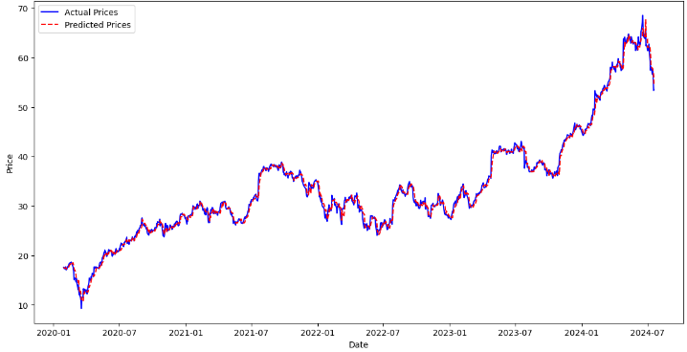
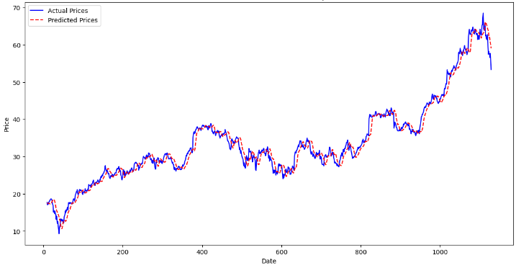
Five Day Rolling Window Model Building
Training on 5-Day Rolling Window
Actual vs Predicted CMG Stock Price
Actual vs Predicted CMG Stock Price (5-Day FWD)
Feature Selection
Stoch_Osc
Stoch_Osc*ADX
ADX
Model Creation: KNN
Euclidean
Uses the last 5 days to predict the 6th day
Uses the last 5 days to predict 5-day FWD
Uniform
N = 30
MSE: 0.7494
R^2 Score: 0.9939
MSE: 1.327
R^2 Score: 0.9759
Notes:
The final model started with key features to help identify the trend and momentum of the stock prices using KNN with a 5-day rolling window approach. The method uses the past 5 days of data to make predictions for the 6th-Day and creates a 5-Day Forward prediction.
The model performed very well when using the last 5 days to predict the 6th day with an MSE below 1 and an R-Squared of 99%.
When predicting the 5-Day forward price, the model still performed quite well with a MSE of ~1.3 and an R-Squared of ~97%.

Slide 28
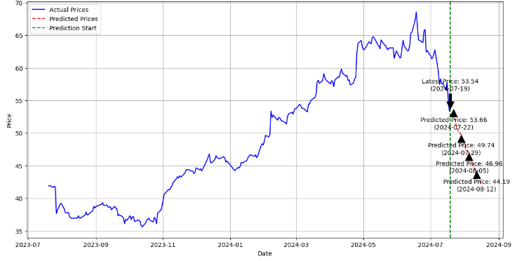
Five Day Rolling Window Implementation
Expanded Feature Selection
RandomForestRegressor
Stoch_Osc, Stoch_Osc*ADX, RSI, MACD, ATR, Fourier, EMA_12*Volume, CMF, FI, and Trend_Strength
Best Hyperparameters
GridSearchCV
Learning Rate: 0.05
Max Depth: 5
Min Leaf: 4
Min Split: 10
N = 100
Subsample: 0.8
CMG: Next 20 Trading Days Compared to Previous 252
CMG Predicted Results
Rolling Window Model | Results
Latest Closing Price (July 19) | $53.54
Predicted Price (July 22) | $53.66
Predicted Price (July 29) | $49.74
Expected Return | (7.09%)
R^2 / MSE | 0.4747 / 0.09
Notes:
We further refined the model to enhance the prediction accuracy by expanding feature selection and utilizing a more sophisticated model, by incorporating RandomForestRegressor optimized with GridSearchCV to provide insights into the importance of different features in making predictions.
The expanded features capture various aspects including momentum, trend strength, volatility, and volume, providing a comprehensive view for the model. Despite some deviations, the model demonstrates strong performance, making it suitable for practical stock price predictions and potential trading strategy development.

Slide 29
Evaluation + Deployment
CRISP-DM Model Part 5+6

Slide 30
Evaluation + Deployment
Allocate, Implement and Monitor the best predictive models and communicate findings to all key stakeholders.
Goal Alignment
Allocate $1 million across the six selected stocks
Maximize short-term profit based on predictive model results
Select Stocks
Very high-risk tolerance
Looking for maximum profits over short investment horizon
Fund Allocation
Which stocks meet our goal of positive short-term returns?
How will the fund be allocated among those stock(s) to maximize profit?
Projected Value
Test the different portfolio options
Pick optimal method to allocate the fund that aligns with our risk tolerance

Slide 31
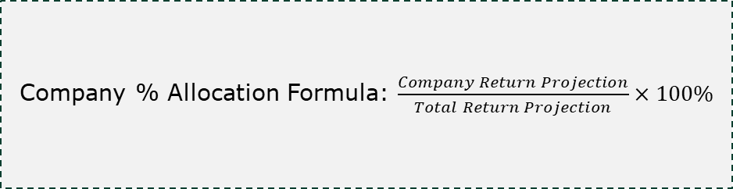
Fund Allocation – Combined Models
Company | 2024-07-19 Closing Price | 2024-07-26 Projected Close | Projected Return (%)
 | $53.48 | $59.45 | +11.04%
 | $33.12 | $32.40 | -2.18%
 | $67.53 | $67.11 | -0.29%
 | $99.18 | $104.72 | +5.59%
 | $135.88 | $117.32 | -13.66%
 | $247.63 | $235.89 | -4.74%
Fund Allocation
Company % Allocation Formula: $\frac{Company Return Projection}{Total Return Projection}×100\%$
EL Return Projection: +5.59%
Total Return Projection: +16.63%
EL % Allocation: +33.60%
CMG Return Projection: +11.04%
Total Return Projection: +16.63%
CMG % Allocation: +66.40%

Slide 32
Fund Allocation – Chipotle Mexican Grill and Estée Lauder
EL % Allocation: 33.60%
Total Fund Amount: $1 Million
EL Dollar Allocation: $336,000
CMG % Allocation: 66.40%
Total Fund Amount: $1 Million
CMG Dollar Allocation: $664,000

Slide 33
Allocation Projection
Company | Portfolio % | Allocation $ | Projected Appreciation | Projected Investment Value
Estée Lauder | 33.6% | $336,000 | +5.59% | $354,782
Chipotle Mexican Grill | 66.4% | $664,000 | +11.04% | $737,306
Total | 100% | $1,000,000 | +9.21% | $1,092,088

Slide 34
Monitoring
Target Price Marker:
Chipotle Mexican Grill
Estée Lauder
CMG Target Price: $59.45
CMG Return Projection: +11.04%
CMG Current Return: -4.58%
EL Target Price: $104.72
EL Return Projection: +5.59%
EL Current Return: +3.03%

Slide 35
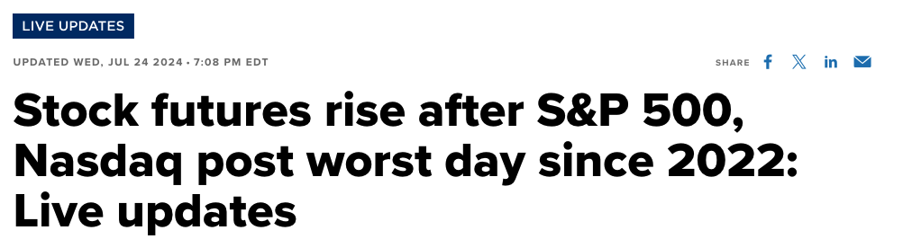

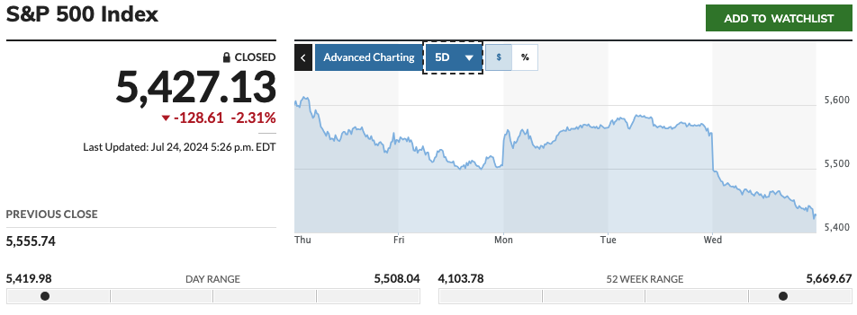
What Happened?
Source: CNBC & Marketwatch

Slide 36
Allocation Reality
Company | Portfolio % | Allocation $ | Actual Appreciation | Actual Investment Value
Estée Lauder | 33.6% | $336,000 | +3.03% | $346,180
Chipotle Mexican Grill | 66.4% | $664,000 | -4.58% | $633,589
Total | 100% | $1,000,000 | -2.02% | $979,769
Total Loss = $20,231

Slide 37

Thank you
- Nate’s Group

